Slide 1
Routing I

Slide 2
Routers and How They Work
A router joins two or more networks and passes packets from one network to another
Routers can do the following:
Connect dissimilar networks (LANs and WANs)
Interpret Layer 3 and often Layer 4 addressing
Determine the best path for data to follow from point A to point B
Reroute traffic if the path of first choice is down but another path is available

Slide 3
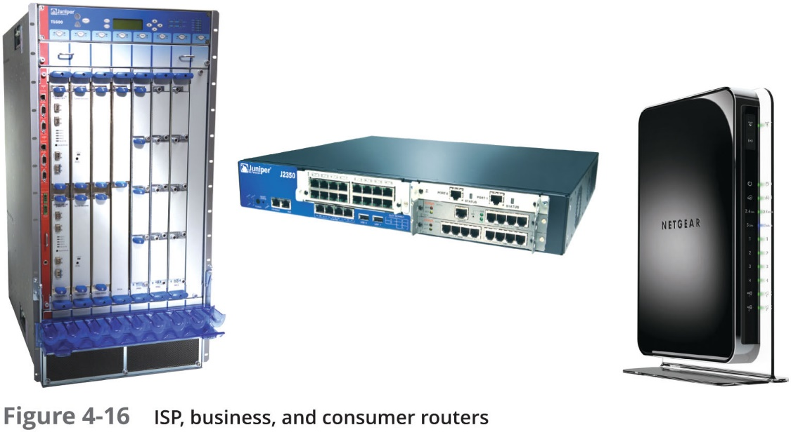
Routers and How They Work

Slide 4
Routers and How They Work
Routers may perform any of the following optional functions:
Filter broadcast transmissions
Prevent certain types of traffic from getting to a network
Support simultaneous local and remote connectivity
Provide high network fault tolerance through redundant components such as power supplies
Monitor network traffic and report statistics
Diagnose internal or other connectivity problems and trigger alarms

Slide 5
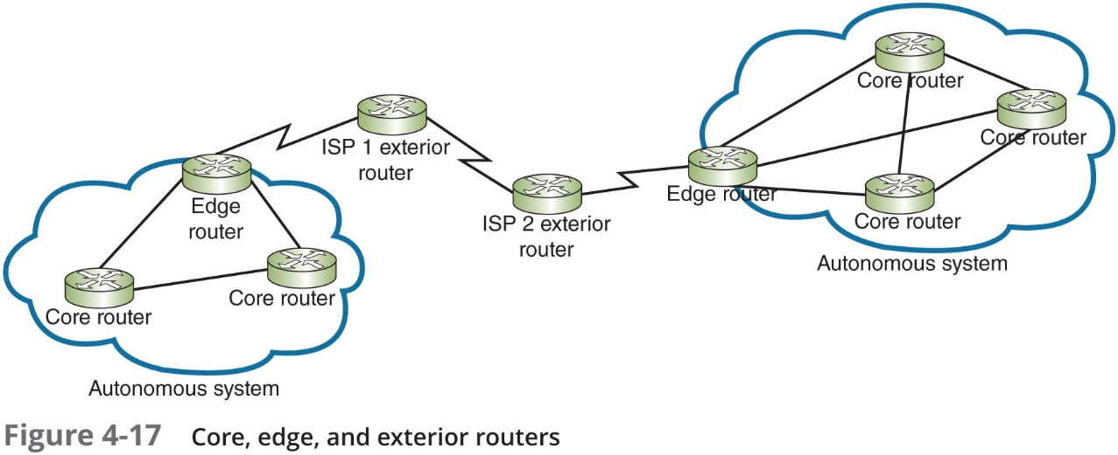
Routers and How They Work
Router categories:
Core routers, also called interior routers—Direct data between networks within the same autonomous system (A S)
Edge routers, or border routers—Connect an autonomous system with an outside network
Exterior routers—Refers to any router outside the organisation’s A S
Direct data between autonomous systems

Slide 6
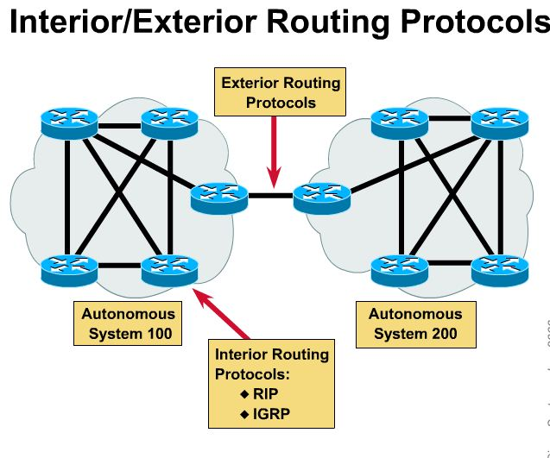
Autonomous Systems
An Autonomous System is a collection of networks under a common administration (a single organisation, ISP or systems administrator) and sharing a common routing strategy.
Typically the world wide organisation ICANN, the ISP, or the administrator assigns a unique AS number to the Autonomous System.
The Autonomous System number uniquely distinguish it from other Autonomous Systems around the world.
Each Autonomous Systems has its own set of rules and policies.

Slide 7
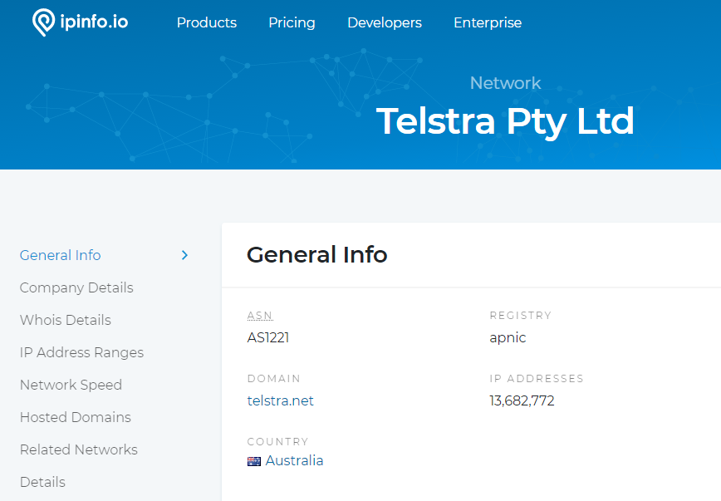

Slide 8
Multilayer Switches
Layer 3 switch—Capable of interpreting Layer 3 data and works much like a router:
Usually faster and less expensive
Primary difference is the way the hardware is built
Layer 4 switch—Capable of interpreting Layer 4 data:
Also known as content or application switches
Enables switch to perform advanced filtering, keep statistics, and provide security functions
Typically used as part of a network’s backbone

Slide 9
Routing Tables
Routing table—A database that maintains information about where hosts are located and the most efficient way to reach them
Routers rely on them to identify which router is the next hop to reach a particular destination host
Routing tables contain IP addresses and network masks that identify a network that a host or another router belongs to

Slide 10
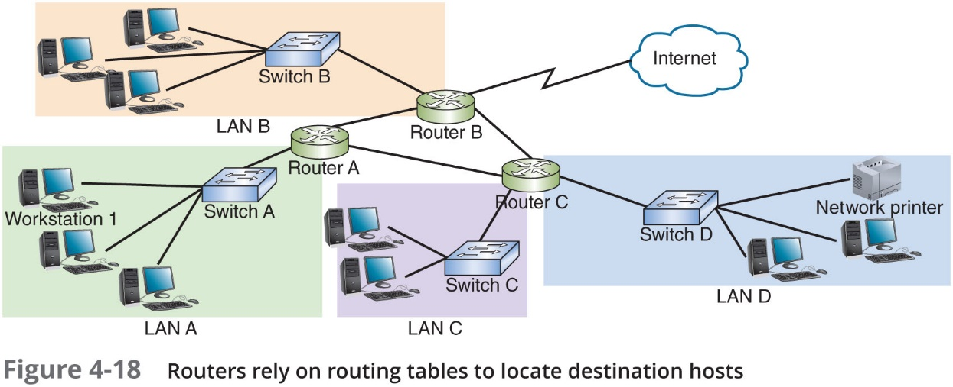
Routing Tables

Slide 11
Routing Path Types
Static routing—Network administrators configures a routing table to direct messages along specific paths
Example—A static route between a small business and its I S P
Dynamic routing—Automatically calculates the best path between two networks and maintains this information in a routing table
Router can detect problems with failed or congested routes and reroute messages through a different path

Slide 12
The route Command
The route command allows you to view a host’s routing table:
On a Linux or UNIX system, use the command route
On a Windows-based system, use the command route print
On a Cisco I O S, use the command show ip route

Slide 13
Routing Metrics
Routing metrics—Properties of a route used by routers to determine the best path to a destination:
Hop count
Theoretical bandwidth and actual throughput
Delay, or latency, on a potential path
Load, or the traffic or processing burden
M T U (maximum transmission unit) or the largest I P packet size in bytes allowable without fragmentation
Routing cost, or a value assigned to a particular route
Reliability of a potential path
Topology of a network

Slide 14
Routing II

Slide 15
Routing Protocols to Determine Best Paths
Routing protocols—Used by routers to communicate with each other to determine the best path
Routers rate the reliability and priority of a routing protocol’s data based on these criteria:
Administrative distance (A D)—A number indicating the protocol’s reliability
Convergence time—Time it takes to recognise a best path in the event of a change or network outage
Overhead—The burden placed on the underlying network to support the protocol

Slide 16
Routing Protocols to Determine Best Paths
Routing Protocol | Type | Algorithm Used
R I P (Routing Information Protocol) | I G P | Distance-vector
R I Pv2 (Routing Information Protocol, version 2) | I G P | Distance-vector
O S P F (Open Shortest Path First) | I G P | Link-state
I S-I S (Intermediate System to Intermediate System) | I G P | Link-state
E I G R P (Enhanced Interior Gateway Routing Protocol) | I G P | Advanced distance-vector
B G P (Border Gateway Protocol) | E G P | Advanced distance-vector or path vector

Slide 17
Interior and Exterior Gateway Protocols
I G P (interior gateway protocols)—Used by core routers and edge routers within autonomous systems and are often grouped according to the algorithms they use to calculate best paths:
Distance-vector routing protocols—Calculate path on the basis of the distance to that destination
Link-state routing protocols—Enables routers to communicate beyond neighbouring routers in order to independently map the network and determine the best path

Slide 18
Interior and Exterior Gateway Protocols
E G P (exterior gateway protocols)—Used by edge routers and exterior routers to distribute data outside of autonomous systems
The only E G P currently in use is B G P

Slide 19
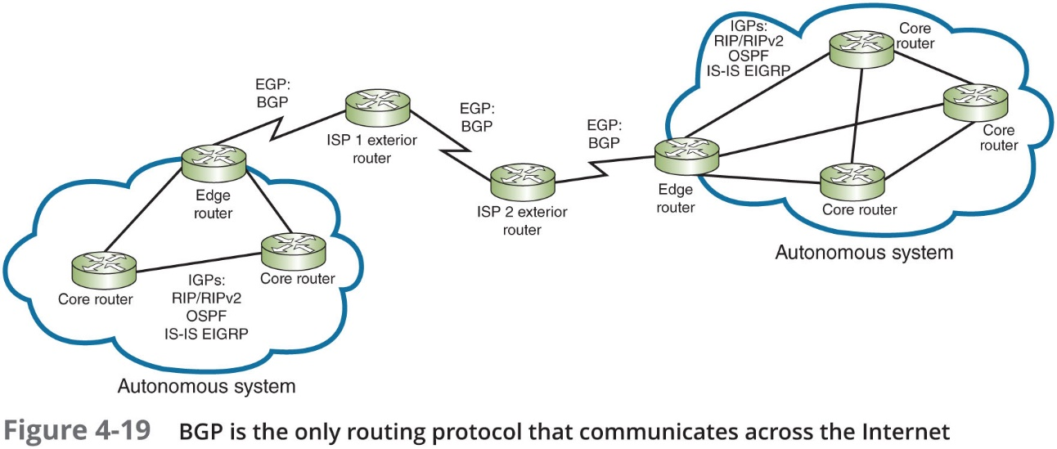
Interior and Exterior Gateway Protocols

Slide 20
Interior and Exterior Gateway Protocols
O S P F (Open Shortest Path First)—An I G P and a link-state protocol used on interior or border routers
Introduced as an improvement to R I P
Characteristics:
Supports large networks—Imposes no hop limits (unlike R I P)
Uses a more complex algorithm for determining best paths
Shared data—Maintains a database of other routers’ links
Low overhead, fast convergence—Demands more memory and C P U power for calculations, but keeps network bandwidth to a minimum and provides a very fast convergence time
Stability—Uses algorithms that prevent routing loops
Multi-vendor routers—Supported by all modern routers

Slide 21
Interior and Exterior Gateway Protocols
I S-I S (Intermediate System to Intermediate System)—An I G P and link-state routing protocol:
Uses a best-path algorithm similar to O S P F
Is designed for use on core routers only (unlike O S P F)
Not handcuffed to I P v 4 (like O S P F) so it’s easy to adapt to I P v 6
Service providers generally prefer I S-I S because it’s more scalable than O S P F

Slide 22
Interior and Exterior Gateway Protocols
E I G R P (Enhanced Interior Gateway Routing Protocol)—An advanced distance-vector protocol that combines some of the features of a link-state protocol
Often referred to as a hybrid protocol
Fast convergence time and low network overhead
Easier to configure and less C P U-intensive than O S P F
Supports multiple protocols and limits unnecessary network traffic between routers
Originally proprietary to Cisco routers

Slide 23
Interior and Exterior Gateway Protocols
B G P (Border Gateway Protocol)—The only current E G P and is known as the “protocol of the Internet”
Can span multiple autonomous systems
A path-vector routing protocol that communicates via B G P-specific messages that travel between routers
Determines the best paths based on many different factors
Can be configured to follow policies that might avoid a certain router or instruct a group of routers to prefer a particular route
The most complex of the routing protocols

Slide 24
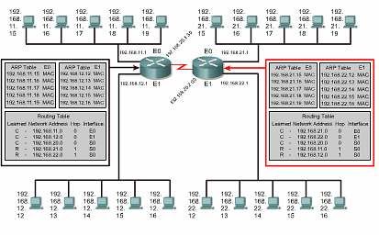
ARP Tables and Routing Tables

Slide 25
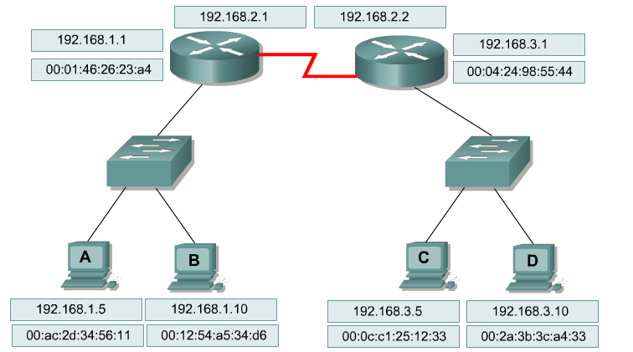
Routing – Role of Layer 2 and Layer 3 Addressing
Remember: Regardless of the routing protocol, packets travel across each individual link in a new frame of the appropriate format for the protocol running over that link.
1. From Host A to the router FastEthernet interface: Ethernet frame
2. Over the serial link on the left router to the right router: HDLC frame
3. From the router FastEthernet interface to Host D: Ethernet frame

Slide 26
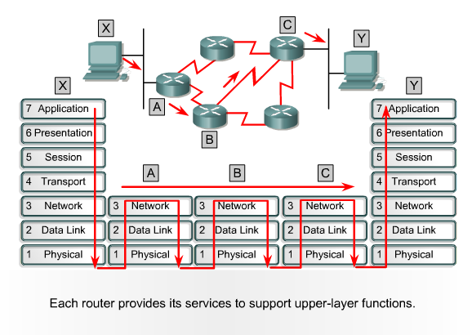
Forwarding an IP Packet
When a frame is received at a router interface.
The MAC address is checked to see if the frame is either addressed to the router interface or is a broadcast
The frame header and trailer are removed, and the packet is passed up to Layer 3
The routing table is examined to check for a match with the destination IP address of the packet
A match will identify the IP address of the directly connected next hop interface.
The next hop IP is only used to look up the MAC address of the next hop interface in the ARP table to construct a frame
The packet is placed into the new frame with the MAC address of the next hop interface as the destination address
The frame is queued on the appropriate outgoing interface until it is transmitted

Slide 27
Subnet Mask

Slide 28
Network Segmentation (1 of 2)
When a network is segmented into multiple smaller networks, the following occurs:
Traffic on one network is separated from another network’s traffic
Each network is its own broadcast domain
Segmentation accomplishes the following goals:
Enhance security
Improve performance
Simplify troubleshooting

Slide 29
Network Segmentation (1 of 2)
Networks are commonly segmented according to one of the following groupings:
Geographic locations
Departmental boundaries
Device types

Slide 30
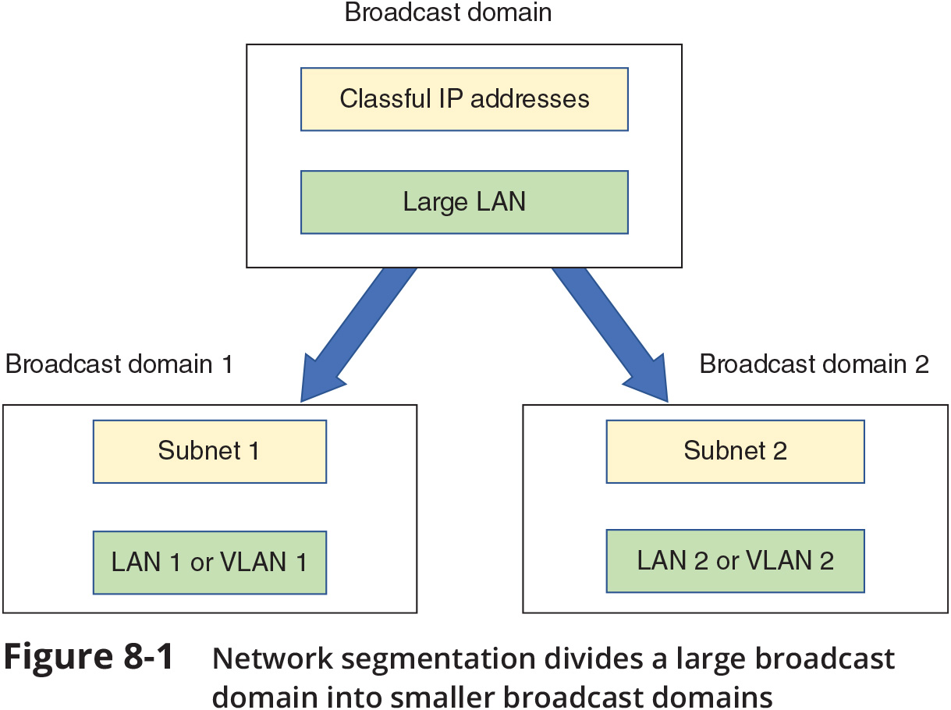
Network Segmentation (2 of 2)

Slide 31
Why Subnets?
Example: A business has grown from 20-30 computers to having a few hundred computers on three floors
There is only a single LAN or broadcast domain
One router serves as the default gateway for the entire network
To better manage network traffic, segment the network so that each floor contains one LAN, or broadcast domain

Slide 32
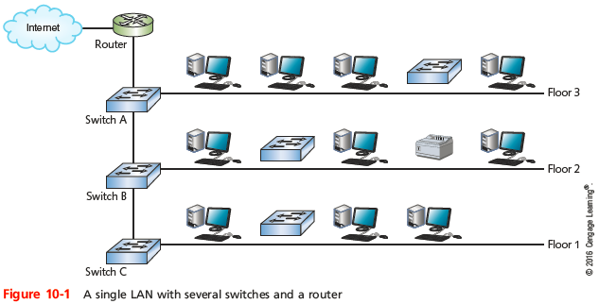
Why Subnets?
Notes:
Why Subnets?

Slide 33
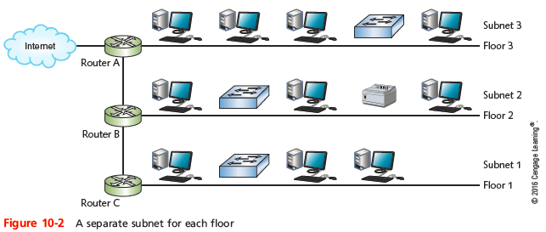
Why Subnets?
Notes:
Why Subnets?

Slide 34
Subnet Masks (1 of 2)
Example: A business has grown from 20-30 computers to having a few hundred computers and devices
There is only a single LAN or broadcast domain
One router serves as the default gateway for the entire network
To better manage network traffic, segment the network so that each floor contains one LAN, or broadcast domain
You will need to configure clients on each subnet, so they know which devices are on their own subnet
Divide the pool of IP addresses into three groups or subnets (a technique called subnetting)

Slide 35
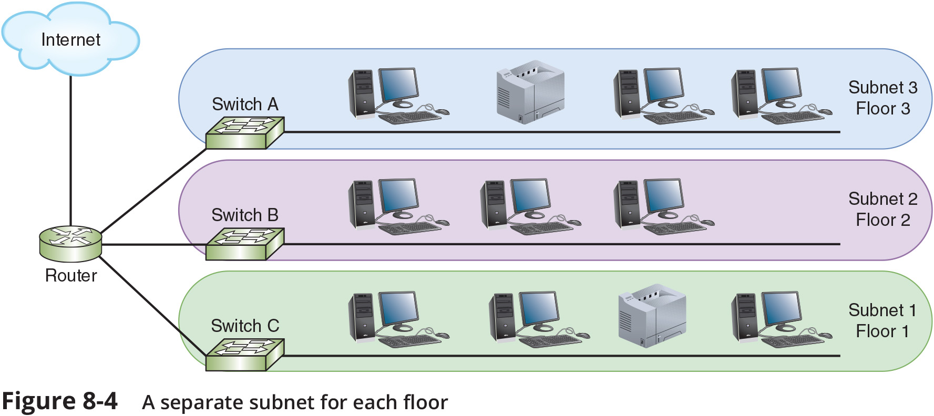
Subnet Masks (2 of 2)

Slide 36
How Subnet Masks Work
An IPv4 address is divided into two parts: a network ID and a host ID
A subnet mask is used so devices can determine which part of an IP address is the network ID and which part is the host ID
The number of 1s in the subnet mask determines the number of bits in the IP address belong to the network ID
IP address 192.168.123.132 in binary:
11000000.10101000.01111011.10000100
Subnet mask 255.255.255.0 in binary:
11111111.111111111.111111111.00000000
Network ID: 192.168.123.0
Host portion: 0.0.0.132

Slide 37
Calculating Subnet Masks

Slide 38
Calculating Subnets
Subnetting alters the rules of classful IPv4 addressing and is called classless addressing
To subnet a network, you borrow bits that would represent host information in classful addressing
Use those bits instead to represent network information
By doing so, you increase the number of bits available for the network ID (increase the number of networks)
You also reduce the number of bits available for identifying hosts (decrease number of hosts per network)

Slide 39
IPv4 Subnet Calculation in Binary
Example: Create two subnet of network ID: 192.168.89.0 with an original subnet mask of 255.255.255.0
Steps to subnet:
1. Borrow from host bits
2. Determine the subnet mask
3. Determine the network IDs
4. Determine the ranges of IP addresses for hosts in the subnet

Slide 40
IPv4 Subnet Calculations Using Formulas
Steps to subnet a network ID of 192.168.89.0 into six subnets using formulas:
1. Decide how many bits to borrow
2. Determine the subnet mask
3. Calculate the network ID for each subnet
4. Determine the IP address range for hosts in each subnet
When calculating subnets, you’ll work with the following information:
Number of subnets
Number of host addresses per subnet
Network ID for each subnet
Broadcast address for each subnet
Range of possible host addresses within each subnet

Slide 41
Subnet Mask Tables
Class A, class B, and class C networks can all be subnetted
Each class has a different number of host information bits that can be used for subnet information
The number of hosts and subnets on your network will vary depending on your network class and the way you use subnetting

Slide 42
Subnetting
To create subnets, we reassign (or “borrow) host bits as network bits
We always start at the leftmost host bit
Suppose we wish to subnet class C network address 192.168.10.0
we might borrow two host bits to create subnets
11000000.10101000.00001010.00000000
NNNNNNNN.NNNNNNNN.NNNNNNNN.HHHHHHHH
11000000.10101000.00001010.00000000
NNNNNNNN.NNNNNNNN.NNNNNNNN.SSHHHHHH

Slide 43
Subnetting
Two questions for subnetting:
How many subnets do you need?
How many hosts per subnet do you need?
If you borrow N bits for subnetting, and leave H bits for hosts, then you create:
2^{N} subnets, each consisting of 2^{H} addresses
2 of the addresses are unusable for hosts
The subnet address – host bits set to all 0
The broadcast address – host bits set to all 1

Slide 44
Subnetting Example
So, if we borrow 2 bits for subnets, and leave 6 bits for hosts
We have 2² = 4 subnets
Each with 2⁶ = 64 addresses
And 64 - 2 = 62 usable host addresses
Subnet # | Subnet ID | Broadcast ID | Host Range
0 | 192.168.10.0 | 192.168.10.63 | .1 - .62
1 | 192.168.10.64 | 192.168.10.127 | .65 - .126
2 | 192.168.10.128 | 192.168.10.191 | .129 - .190
3 | 192.168.10.192 | 192.168.10.255 | .193 - .254

Slide 45
Subnetting
We also need to determine the subnet mask
We borrowed 2 bits from 192.168.10.0
24 network bits, 2 subnet bits, 6 host bits
NNNNNNNN.NNNNNNNN.NNNNNNNN.SSHHHHHH
So, the mask is
11111111.11111111.11111111.11000000
= 255.255.255.192 (note that 256 – 64 = 192)
More compactly: /26

Slide 46
Using the Subnet Mask to Extract the Subnet Address
Packet Address | 192.168.10.71 | 11000000.10101000.00001010.010 | 00111
Subnet Mask | 255.255.255.224 | 11111111.11111111.11111111.111 | 00000
Subnet Address | 192.168.10.64 | 11000000.10101000.00001010.010 | 00000
The router ANDs the subnet mask with the packet address to determine the subnet address
From the destination IP address of 192.168.10.71 the router will determine that the host is on the 192.168.10.64 subnet

Slide 47
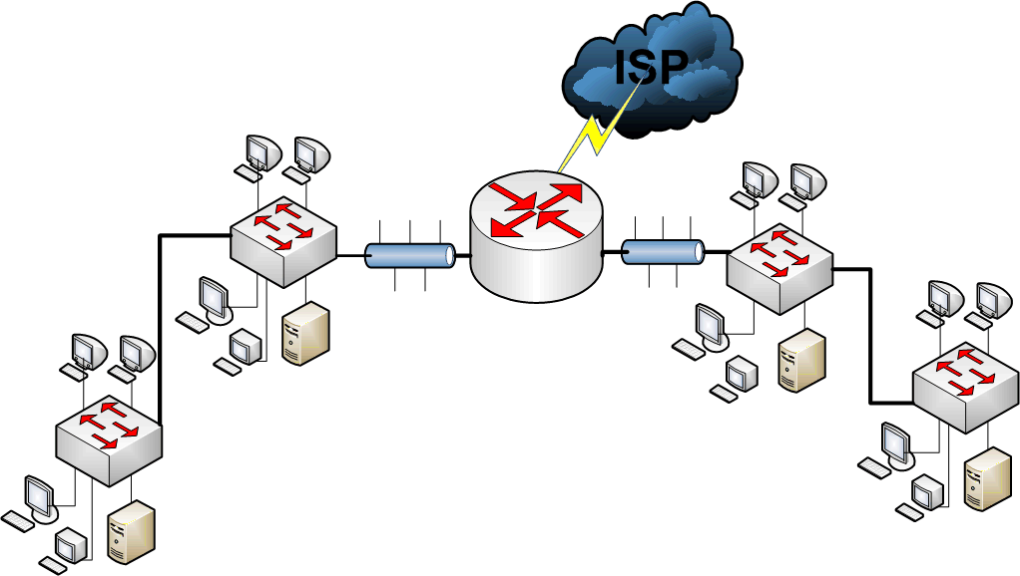
Example 1 - 200.1.1.0
Scenario:
Company office has 150 nodes on one network
Requires security for a new business unit (50 nodes)
Need to improve performance on the overall network
Subnet using the main router.

Slide 48
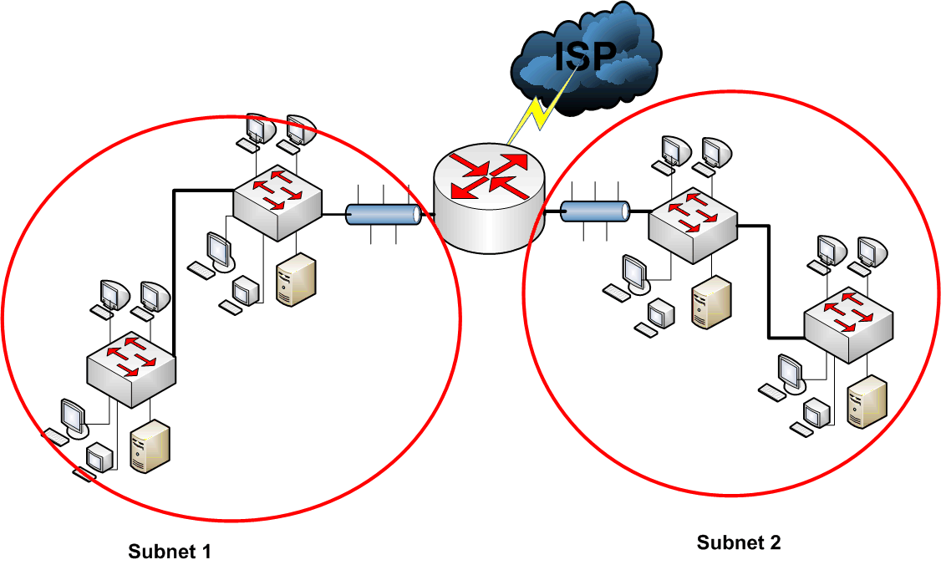
Example 1 - 200.1.1.0
Subnet # | Subnet ID | Host Range | Broadcast ID
0 | 200.1.1.0 | 200.1.1.1 - .126 | 200.1.1.127
1 | 200.1.1.128 | 200.1.1.129 - .254 | 200.1.1.255
We need two subnets
So, we borrow 1 bit, as 2¹ = 2
Which leaves 7 host bits, for 2⁷ = 128 addresses per subnet

Slide 49
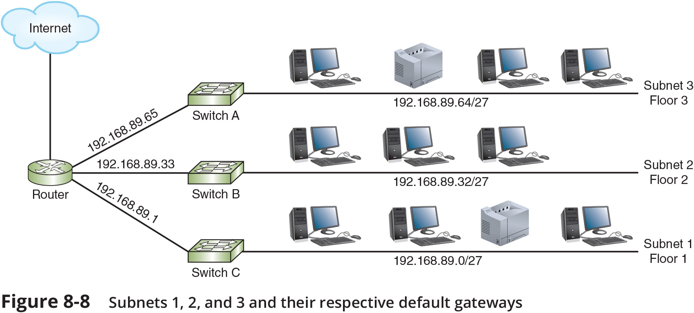
Implementing Subnets on a Network (1 of 3)

Slide 50
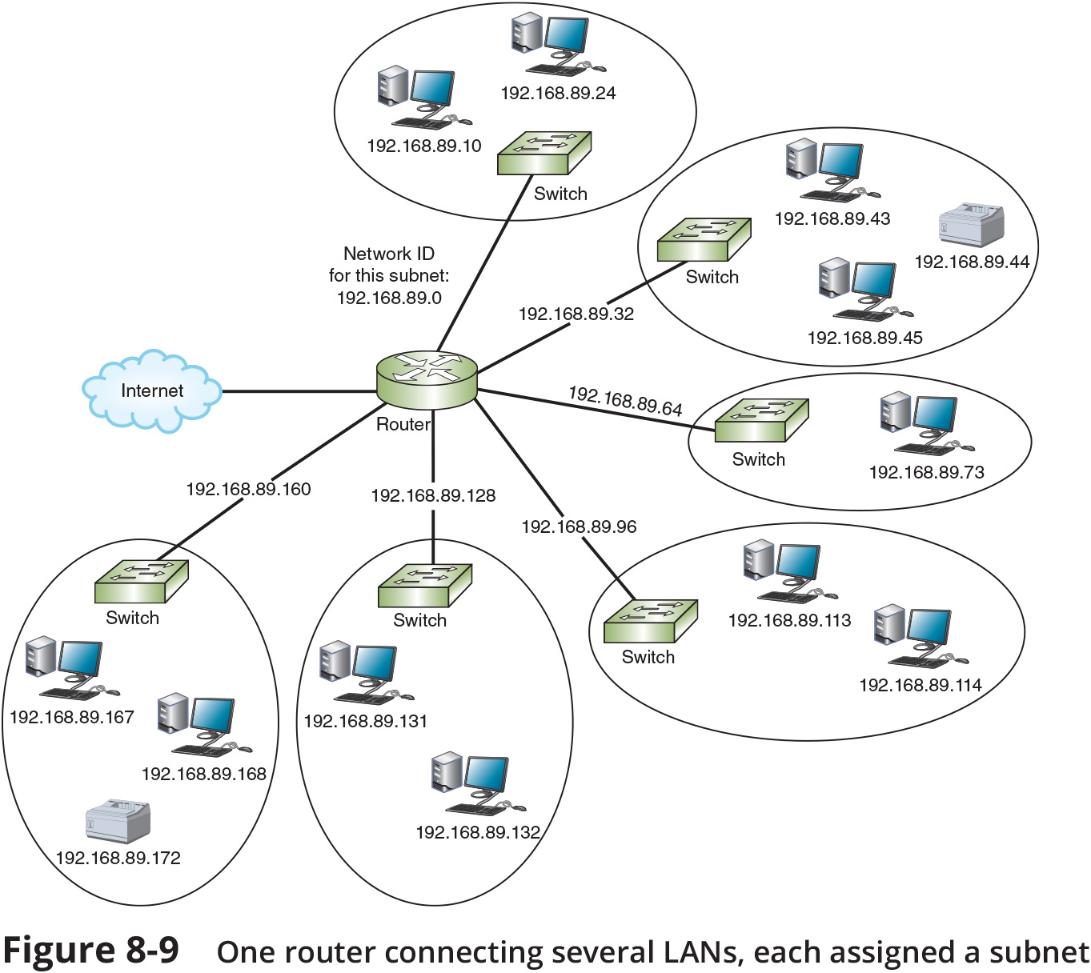
Implementing Subnets on a Network (2 of 3)

Slide 51
Implementing Subnets on a Network (3 of 3)
A centrally managed DHCP server can provide DHCP assignments to multiple subnets with the help of DHCP relay agent
A DHCP relay agent programmed to support UDP forwarding on port 67 receives the DHCP request from a client in one of its local broadcast domains
The relay agent repackages the message with the IP helper information and routes this transmission to its new destination in a different broadcast domain
The DHCP server notes the relay agent’s source interface IP address and assigns the DHCP client an IP address on the same subnet

